Slide 1

Using 'Dotnet Tools' to create Reusable and Shareable Tools and Applications
Rick Strahl
West Wind Technologies
west-wind.com
weblog.west-wind.com
Session materials:
https://github.com/RickStrahl/CodeMagazine-DotnetTools

Slide 2






Rick Strahl
Big Kahuna & Janitor West Wind Technologies
Author and Speaker
Popular Blog: weblog.west-wind.com
ASP.NET Insider and MVP
Tools and Components
@RickStrahl
rstrahl@west-wind.com
weblog.west-wind.com

Slide 3
“A Dotnet Tool is a glorified .NET Core Console application that can be easily shared and installed via NuGet.”
Me, 2020

Slide 4
So Really… What’s a Dotnet Tool?
An easy way to Share .NET Core Binaries
Allows distribution of binary Applications
Uses NuGet for publishing and consuming
Cross Platform – goes anywhere .NET Core goes
Shareable User Created Tools
Easy to Create
Easy to Publish
Easy to Consume
Easy to Update
Quick to Uninstall
But: Requires .NET Core SDK
Not a generic Application Package Manager
Requires .NET Core SDK to consume

Slide 5
“Did you just describe NPM?”
Yup! Dotnet Tool is very much like NPM for .NET Core.
Me, 2020

Slide 6
Benefits for Developers and Community
Easy to build
Uses standard .NET Core projects
Uses existing NuGet Infrastructure
Nothing new to learn – it just works with existing tech
Sharing
Can be easily shared
No store review process makes publishing quick and easy
Makes it easy to expose tools to a large pool of users
Community
Ease of use and shareability promotes creation of small tools
Shared content helps build community
Security
No review for vulnerabilities or malicous intent on publishing
Be careful: You have to trust the publisher or source

Slide 7
Binary or Dotnet Tool?
Dotnet Tools are easy to Share
You can easily install a dotnet tool through the SDK
Easily share across the organization or the Internet
Dotnet Tools are Platform Agnostic
Dotnet Tools can run cross-platform
No separate binaries for each platform
Dotnet Tools have small Distribution Size
Only the your .NET assemblies need to be distributed
Binaries can be Self-Contained
Binaries can be built with everything they need to run
But: Dotnet Tools require the .NET Core SDK to run

Slide 8
What can you use Dotnet Tools for?
Build and Dev Time Tools
Original design goal was for project helpers
Example: dotnet ef tools Dotnet Tool
Example: dotnet watch (built in)
Generic Command Line Tools
Can be used for much more than dev tools
Generic Utilities: Converters and OS Tools
Shell Utils: Complex File Operations – one step above Powershell/bash etc.
Local Servers
You can run ASP.NET Core Servers locally
Run SPA apps locally
Hybrid Applications - desktop UI running browsers
UI Applications (WPF/WinForms) work too!
WinForms and WPF applications work
Not cross-platform
Require .NET Core Desktop Runtimes (SDK installed, but not in 5.0)

Slide 9
Creating and using Dotnet Tools
create, publish, manage and consume

Slide 10
Dotnet Tools Infrastructure
Uses Standard .NET Core Projects
Has to be executable (Console, WPF/WinForms)
Use <PackAsTool>
Publish with NuGet
Nuget publish command like any other package
Install and Manage with Dotnet Tool Command
Dedicated SDK Command to Install and Update
Install
Update
Uninstall
List

Slide 11
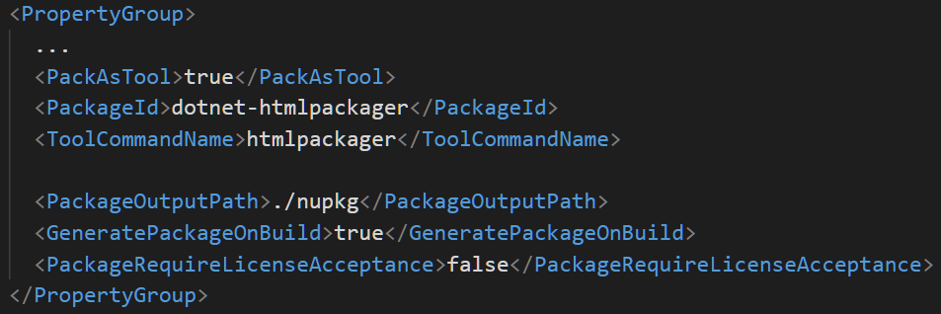
Creating a Dotnet Tool Project

Slide 12
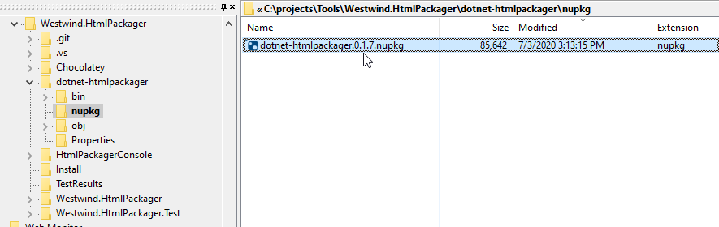
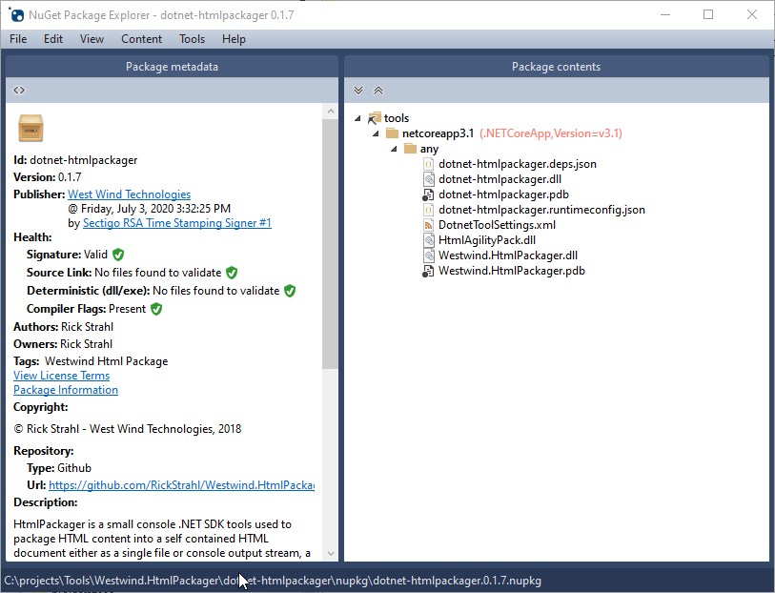
NuGet Package

Slide 13


Install and Manage Dotnet Tools
Install
Manage Tools
Install from a local folder for Testing

Slide 14
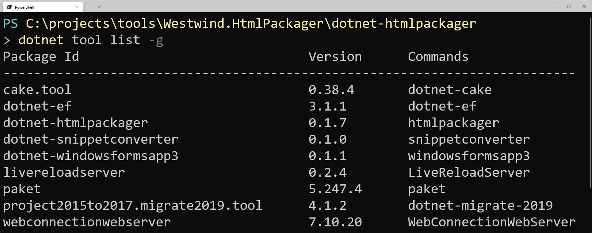
Listing Installed Components

Slide 15
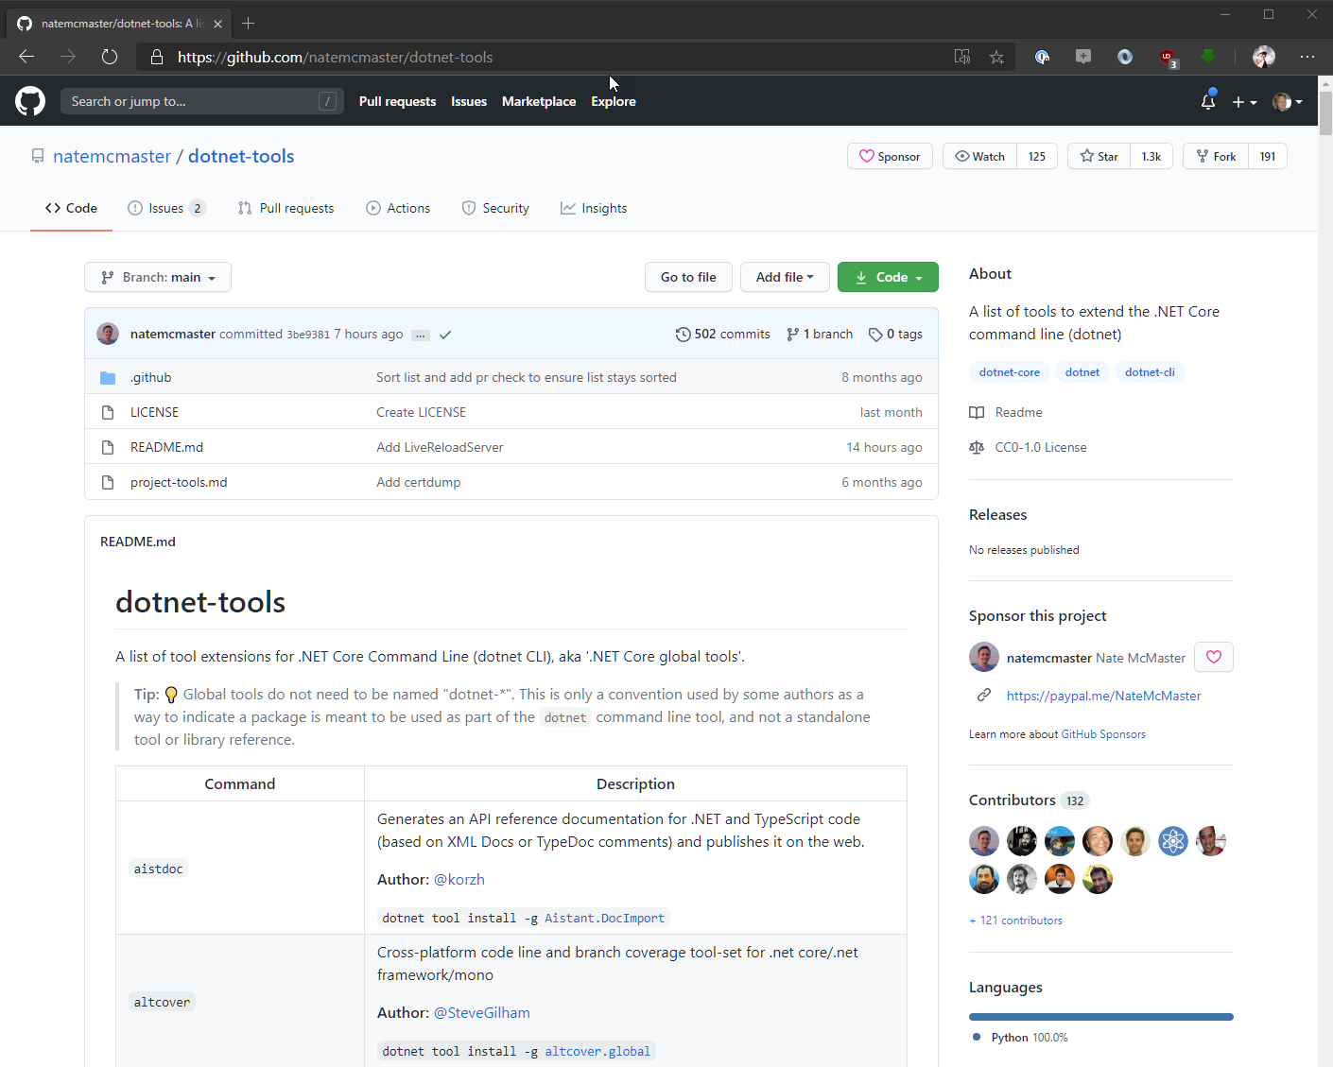
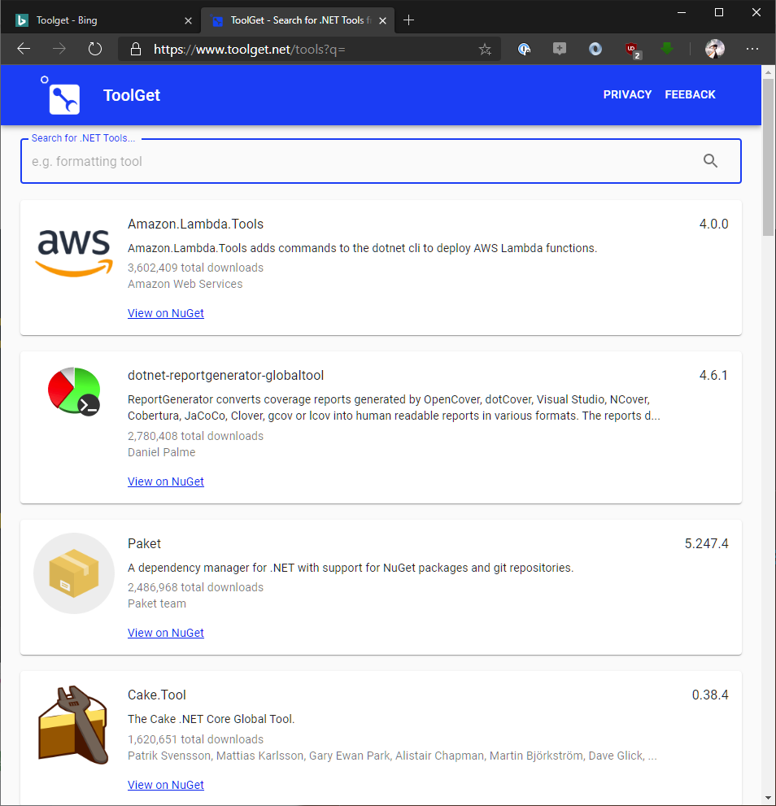
Search for Public Dotnet Tools
Dotnet Tools List GitHub Repository https://github.com/natemcmaster/dotnet-tools
ToolGet Search Site https://www.toolget.net/

Slide 16
Running a Dotnet Tool
Run by Toolname
Important: Toolname may be different than package name
Dotnet Tools are added to the global OS path
Works like you’d expect an executable to work
Uses a Launcher: Not a typical Executable
Dotnet Tools are ‘proxied’
Creates a smaller ‘launcher’ executable
Launcher has same name as Toolname
Launcher lives in a known location
Launcher is a native OS specific Bootstrapper

Slide 17
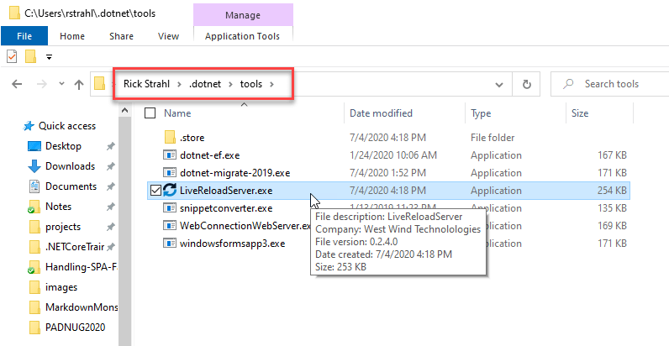
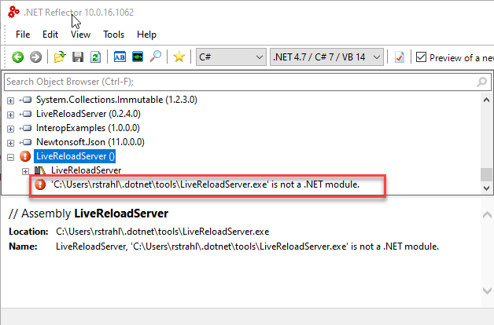
How does the Pathing work?

Slide 18
Dotnet Tool Examples
Some tools I’ve built and published

Slide 19
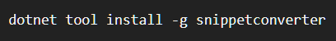
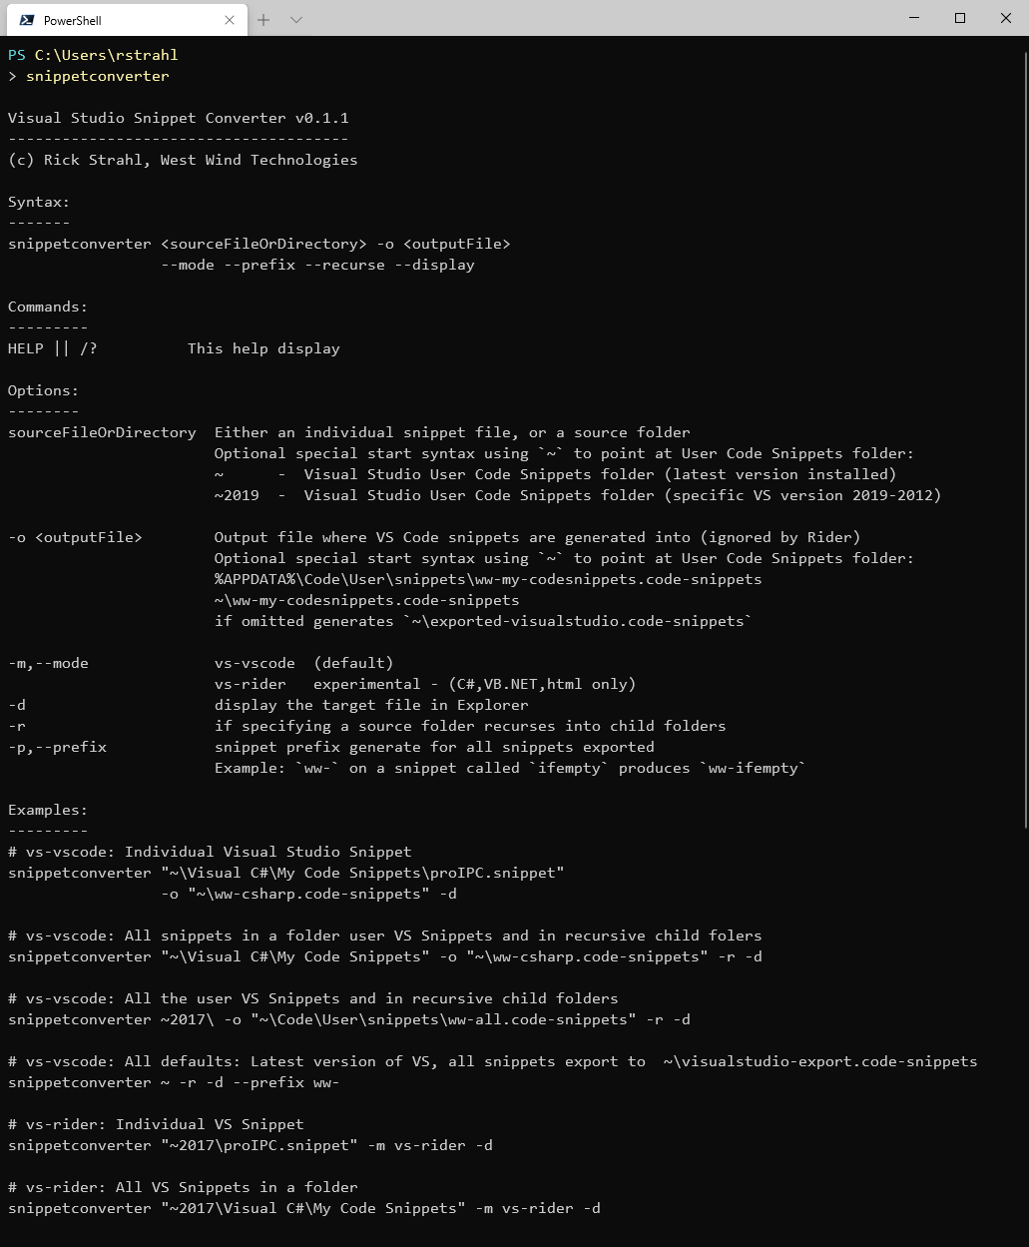
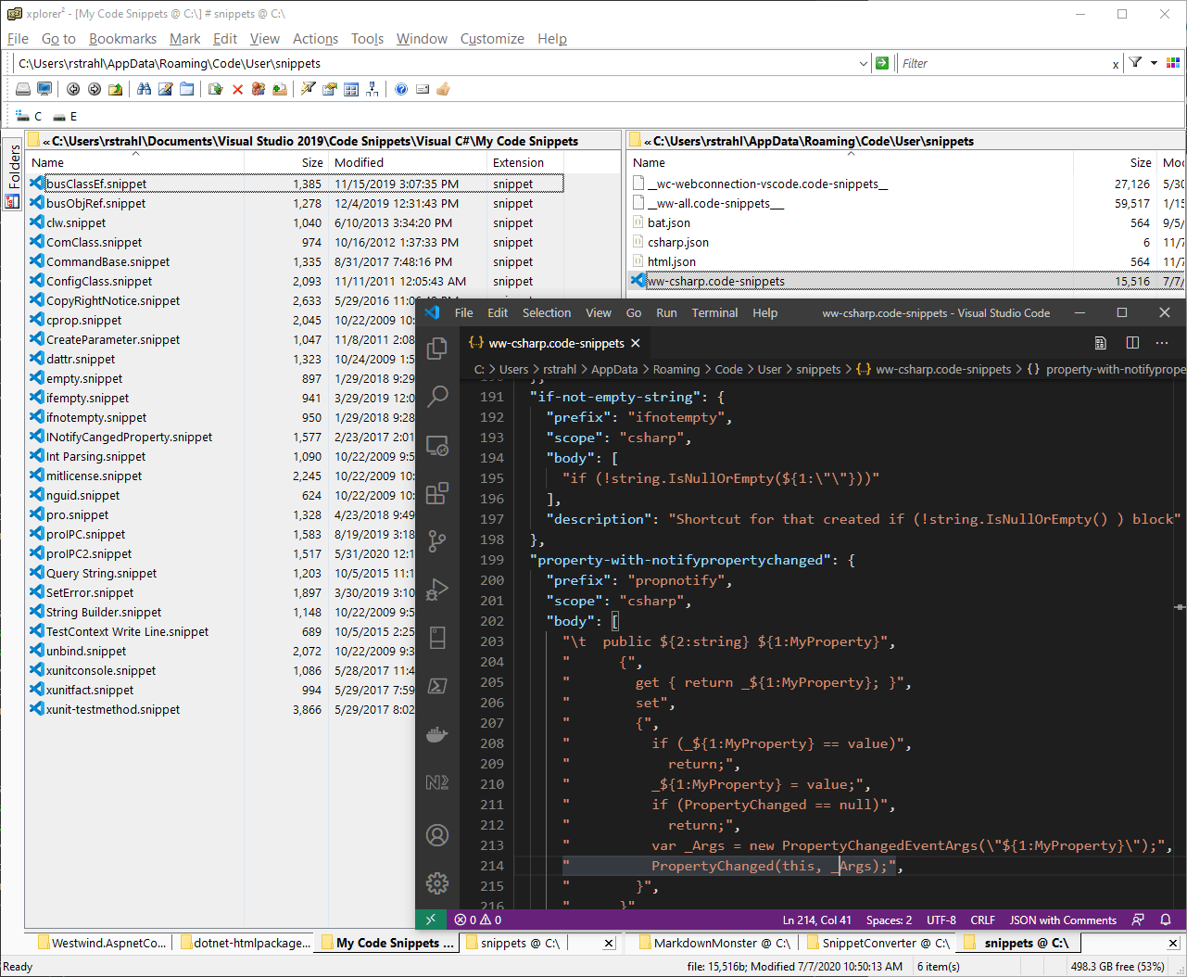
Visual Studio Snippet Converter
Converts Visual Studio Snippets
To Visual Studio Code
Rider

Slide 20
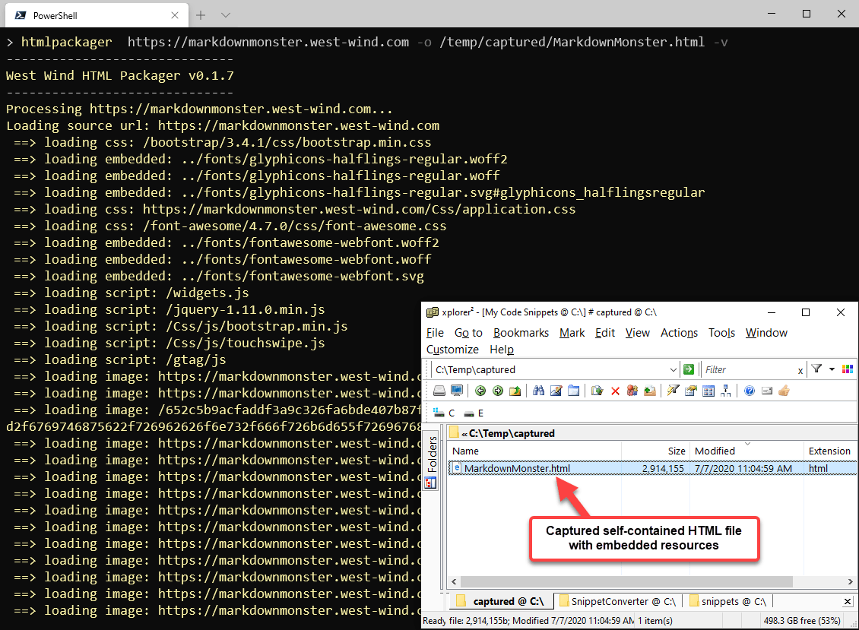
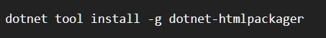
Html Packager
Takes a URL and turns it into a self-contained HTML Package
Single, very large self-contained HTML file
Folder of loose files
Zip file of loose files

Slide 21
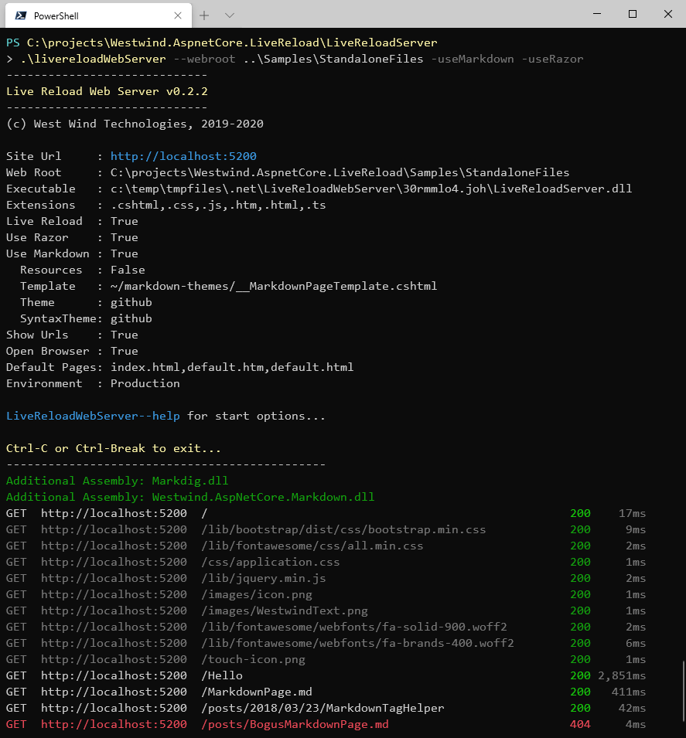
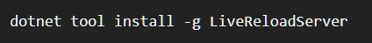
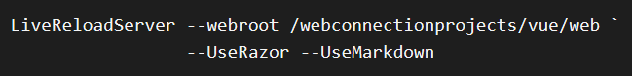
Live Reload Server
Generic Static Web Server
Local or Networked Web Server
Built in Live Reload
Built in loose Razor Page Support
Built in Markdown Document Support
Just point at a folder and go

Slide 22
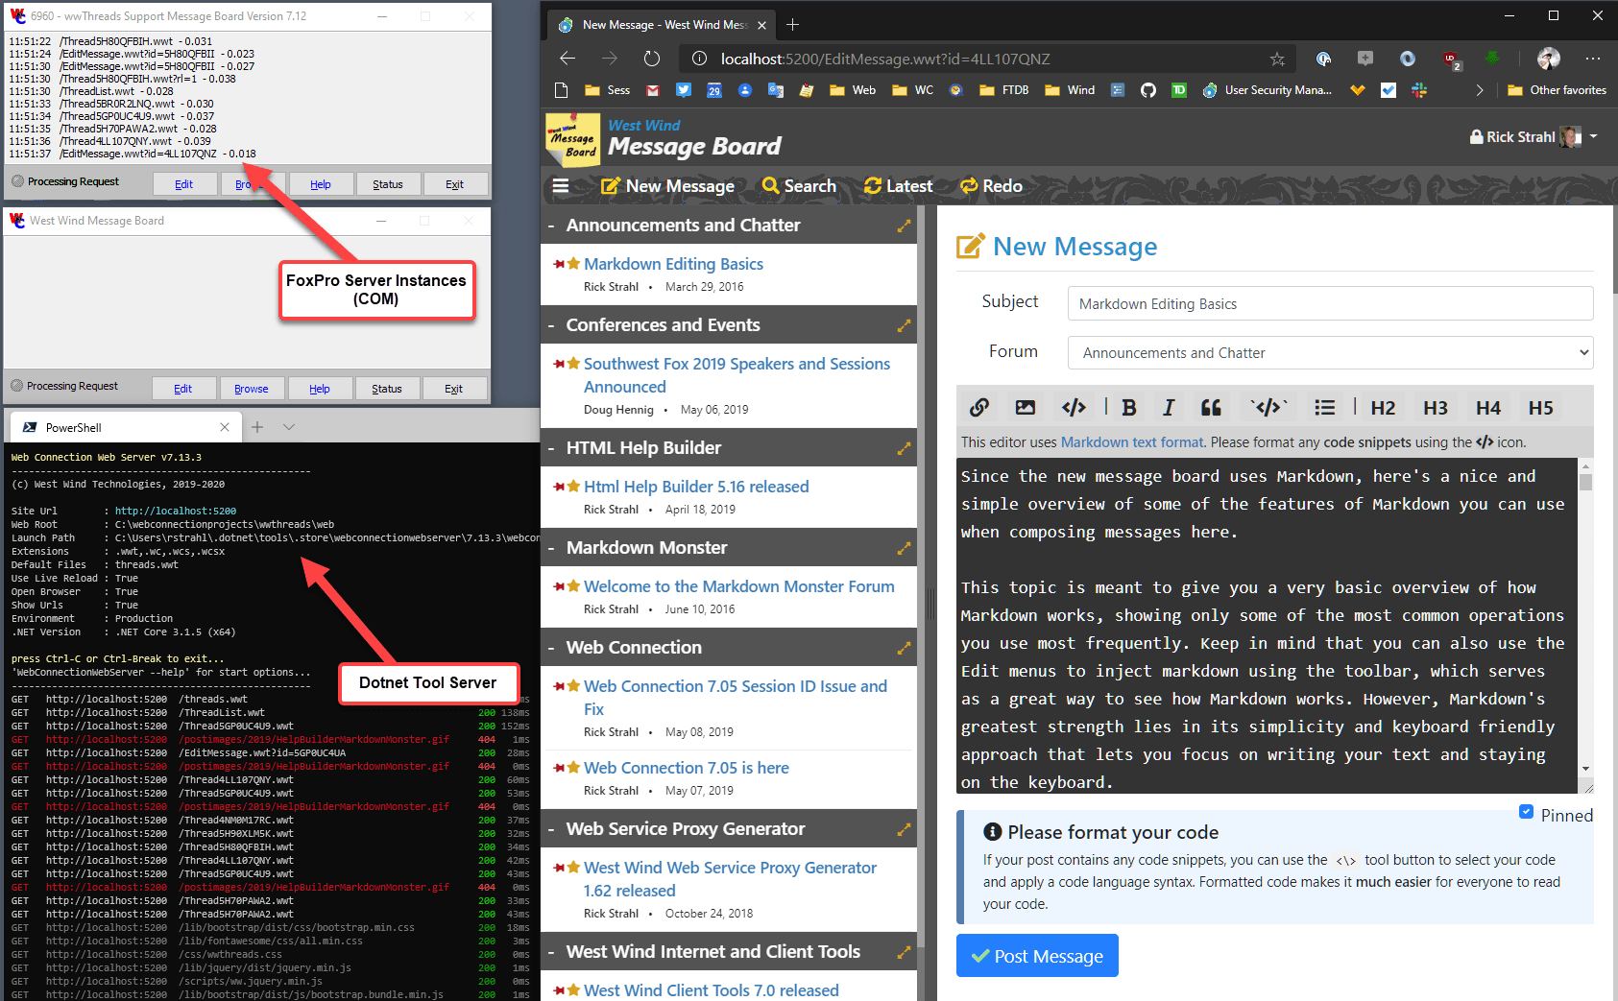
Legacy Application Server
FoxPro Interface
West Wind Web Connection
Ultra Legacy – 25 year old tech
Updated with new technology
Continues to serve 1000’s of customers
Server
Provides Web integration to FoxPro
Passes request and response data
FoxPro runs as Application Server
Used to build FoxPro Web apps
Benefits
No Web Server requirements
Much easier configuration
Easy installation
Potential for cross platform
Zero config for local Dev setup

Slide 23
Dotnet Tools Summary
Shareable Dotnet Tools
Easy to create – regular .NET Core projects
Easy to share – uses NuGet infrastructure
Easy to consume – dotnet tool install -g
Easy to update, uninstall and manage
Benefits
Helps you share your work both internally and publicly
Promotes building of small tools
Builds community – the more the merrier
It’s a great delivery mechanism for tools!
But: Requires installed .NET Core SDK

Slide 24
Thank you!
Resources
Github: White Paper, Slides and Links https://github.com/RickStrahl/CodeMagazine-DotnetTools
Contact Rick
@RickStrahl on Twitter
https://weblog.west-wind.com
rstrahl@west-wind.com

